Slide 1
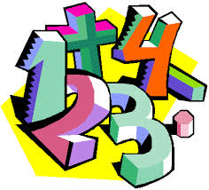
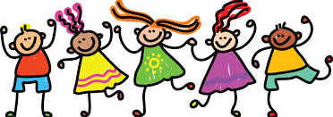
As writers we will be:
Working on fiction, non-fiction and poetry.
Segmenting words and using our phonics skills to spell words.
Leaving spaces between words.
Using capital letters, full stops and question marks correctly.
Sequencing sentences to form short narratives.
Continuing to practise our letter formation.
As scientists we will be:
Learning that there are 4 seasons and be able to name them
Observe and describe weather associated with the seasons and how day length varies
Working scientifically by using our observations and ideas to suggest answers to questions
Performing simple tests to make comparisons about the amount of rainfall over 5 weeks.
Gathering and recording data to help answer questions.
As mathematicians we will be:
Counting within 20.
Securing place value of numbers up to 20.
Identifying 1 more / 1 less of numbers up to 20.
Using number lines to estimate, compare and order numbers
As athletes we will be:
developing our fundamental movement skills including:
hopping, jumping, travelling backwards, dodging and evading.
As gymnasts we will be:
practising spins and balances and working towards developing sequences and routines.
Which is your favourite season and why?
Spring 1
As artists and designers we will be:
Using clay creatively.
As Geographers we will be:
Identifying sseasonal & daily weather patterns in the UK and the location of hot and cold areas of the world
In Computing we will be:
Writing short algorithms and programmes for floor robots and predicting outcomes.
Throughout the topic we will be working on:
Continuing to be more independent and doing
things for ourselves
Continuing to be responsible for ourselves and our classroom
Trying to challenge ourselves across our learning.
We will be focusing on the Learn Together strand of Belief Systems. Our theme is ‘Seasons’ and we will be learning about Atheism, Agnosticism and Humanism.

